Slide 1
University of Minnesota
Data Visualization and Analytics
Project Two – Mississippi River Golf Adventure
October 23, 2020
Presented by Team 5

Slide 2
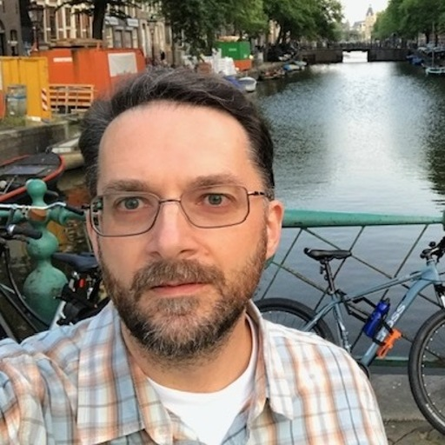


Meet the Team
Jeff Brown
Emily Frels
Jeanine Vincent

Slide 3
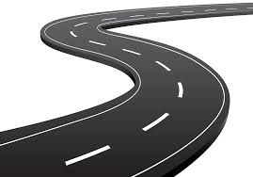

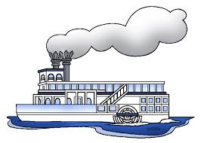

Mississippi River Golf Adventure
The ultimate golf road trip
The beating heart of America lies in its great middle and the pulsing artery of the nation is the Mississippi River
It stretches from its headwaters in icy Lake Itasca in Northwestern Minnesota and flows more than 2,300 miles to the Golf of Mexico
An opportunity to discover America through it’s golf courses and experience a wide range of American regional culture

Slide 4
Project Approach
STEP 1
“ETL”
STEP 2
“ORM”
STEP 3
“Beautify”
STEP 4
“Information Kiosk”
Read CSV into dataframe
Use SQL Alchemy to connect to database in Python
Read all data to generate points on map based on lat-lng. Form data groupings (by color)
Search Page – enter key word then search by course name, access, and holes.
Clean the data
Read database
Retrieve longitude and latitude
Establish Flask Server and establish routes – one route is dedicated to passing data.
Pass data to initial plotting routine. Generate initial doughnut and parallel coordinate
Search Page – calculate course handicap based off course values.
Transform the data
About page gives details of project.
Mild profanity
Using mouse.on populate pop up with relevant data. Also call plotting routine to update graphs to chosen course.
Load details into PostgreSQL database
Confirm presence of data in HTML/Javascript Index page
Mild profanity, followed by cheers.

Slide 5
Mississippi River Golf Adventure

